Slide 1
أكـــــاديميــــة طــــويـــق
Deep Learning

Slide 2
AutoEncoders
By: Dr. Afshan Hashmi

Slide 3
Topics Covered:
What is an Autoencoder
Architecture of Autoencoders
Loss Functions in Autoencoder Training
Types of Autoencoders
Implementation of Autoencoders
Limitations of Autoencoders

Slide 4
Autoencoder
An autoencoder is a type of artificial neural network designed to learn a compressed, efficient representation of input data and then reconstruct that data as accurately as possible.
Components:
Encoder:
Compresses the original input data into a lower-dimensional, compact representation (often called the "latent space" or "bottleneck layer").
Its goal is to capture the most relevant and essential features of the input.
Decoder:
Takes the compressed representation from the encoder as input.
Reconstructs the data, aiming to make the output as similar as possible to the original input.
How it Works (Example):
If you input a noisy image of handwritten digits, the autoencoder will learn to:
Compress the noisy image into a smaller set of features (encoder).
Reconstruct a cleaner version of the original image from these features (decoder), effectively removing the noise.

Slide 5
Autoencoder
Training Objective:
Goal: Minimize the reconstruction error, which is the difference between the original input and the autoencoder's reconstructed output.
Loss Functions: Commonly uses Mean Squared Error (MSE) for continuous data or Binary Cross-Entropy (BCE) for binary data.
Optimization: Trained using backpropagation and gradient descent to adjust its internal parameters.
Applications:
Image Processing: Denoising, image compression.
Anomaly Detection: Identifying data points that deviate significantly from learned patterns.
Noise Removal: As in the example, cleaning up corrupted data.
Feature Extraction: Learning meaningful, lower-dimensional representations of data that can be used for other machine learning tasks.

Slide 6
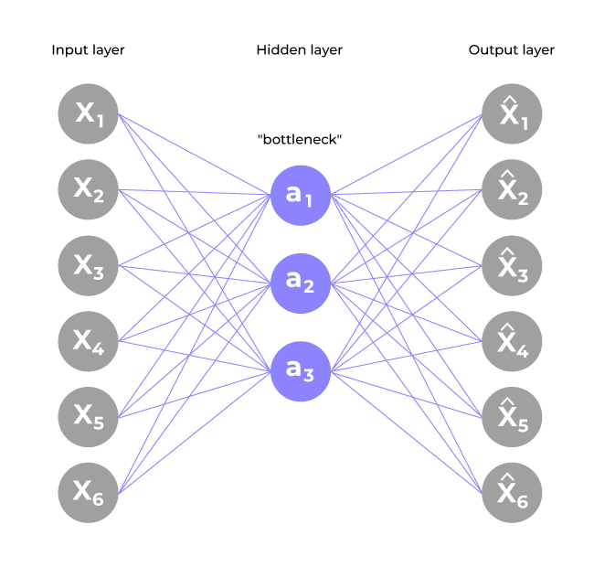
Architecture of Autoencoder in Deep Learning
An autoencoder's architecture is composed of three primary interconnected components: the Encoder, the Bottleneck (Latent Space), and the Decoder.
Encoder:
Function: This is the initial part of the network responsible for taking the raw input data and compressing it into a smaller, lower-dimensional representation.
Input Layer: The entry point for the original data into the network (e.g., pixel values of an image, or a vector of features).
Hidden Layers: A series of layers that apply non-linear transformations to the input data. These layers progressively reduce the dimensionality of the data, extracting essential features and patterns.
Output of Encoder (Latent Space): The final output of the encoder is the compressed version of the data, often referred to as the latent representation or encoding. This is a condensed, feature-rich summary of the input, retaining only the most critical information.

Slide 7
Architecture of Autoencoder in Deep Learning
Bottleneck (Latent Space / Code):
Function: This is the central, smallest layer of the autoencoder. It represents the point where the data is in its most compressed form.
Characteristics: It contains a reduced set of features that capture the most important information and underlying patterns from the input data.
Significance: The forced compression through this bottleneck layer compels the network to learn the most salient and meaningful structures within the input data, discarding noise and redundancy.
Decoder:
Function: The decoder's role is to take the compressed representation from the latent space and reconstruct it back into a form that closely resembles the original input data.
Hidden Layers: A series of layers that gradually expand the dimensionality of the compressed data. These layers reverse the compression process performed by the encoder, attempting to recreate the original input's features.
Output Layer: The final layer of the decoder produces the reconstructed data. The autoencoder is trained such that this reconstructed output is as similar as possible to the original input.

Slide 8
Loss Function in Autoencoder Training
During the training process, an autoencoder's primary objective is to minimize the reconstruction loss. This loss quantifies the discrepancy between the original input data and its reconstructed output. The selection of the appropriate loss function is dependent on the nature of the data being processed:
Mean Squared Error (MSE):
Application: Commonly employed for continuous data (e.g., pixel values in an image, numerical features).
Calculation: It measures the average of the squared differences between corresponding values of the original input and the reconstructed output.
Goal: Drives the model to produce reconstructions that are numerically very close to the original inputs.
Binary Cross-Entropy (BCE):
Application: Used for binary data (data points with values of 0 or 1, such as black and white images or categorical binary features).
Calculation: It quantifies the difference in probability distributions between the original binary input and the reconstructed binary output.
Goal: Encourages the model to predict probabilities for the reconstructed output that closely match the binary values of the original input.
By minimizing this chosen reconstruction loss, the autoencoder iteratively adjusts its internal weights. This learning process enables the network to effectively extract and retain only the most crucial and representative features of the input data, which are then compactly stored in the bottleneck (latent space) layer.

Slide 9
Autoencoder: Learning Efficient Representations
The goal of an autoencoder is to learn meaningful, compact, and useful features (efficient representations) from input data. This is achieved by constraining the network during training. After training, typically only the encoder part is used for feature extraction on new, similar data.
Several techniques are employed to encourage efficient representation learning:
Small Hidden Layers (Bottleneck):
By making the bottleneck layer (and sometimes other hidden layers) as small as possible, the network is forced to compress the input significantly.
This compression compels the autoencoder to learn only the most essential and non-redundant features, leading to a more efficient encoding.
Regularization (L1 or L2):
Adding penalty terms (L1 or L2 regularization) to the loss function discourages the network from assigning excessively large weights.
This prevents overfitting and ensures that the learned representations are more generalizable and robust, rather than memorizing specific training examples.

Slide 10
Autoencoder: Learning Efficient Representations
Denoising Autoencoders:
During training, random noise is intentionally added to the input data.
The autoencoder is then tasked with reconstructing the original, clean input from this corrupted version.
This forces the network to learn robust features that represent the true underlying data structure, rather than just copying the noisy input.
Tuning Activation Functions (Sparsity):
Modifying activation functions (e.g., using sparse activations or applying sparsity penalties) can encourage sparsity in the hidden layer.
Sparsity means that only a few neurons in the hidden layer are active at any given time. This forces the network to learn highly discriminative and relevant features, reducing model complexity and improving efficiency.
By implementing these constraints and techniques, autoencoders are compelled to extract the most salient features, resulting in powerful and compact data representations.

Slide 11
Types of Autoencoders
Denoising Autoencoder:
Purpose: Learns to remove noise from corrupted input data.
Training: Random noise is intentionally added to the input during training.
Benefit: Forces the network to learn robust, core features of the data, rather than just memorizing the input.
Sparse Autoencoder:
Characteristic: Has more hidden units than input units, but only a small fraction of them are allowed to be "active" at any given time (sparsity).
Control: Sparsity can be enforced by:
Manually zeroing out hidden units.
Tuning activation functions.
Adding a sparsity penalty term to the loss function.
Benefit: Encourages the learning of highly discriminative and efficient features, reducing model complexity.

Slide 12
Types of Autoencoders
Variational Autoencoder (VAE):
Nature: A generative model that makes assumptions about the underlying probability distribution of the data.
Objective: Learns to approximate the data's distribution, specifically the conditional probability pθ​(x∣z)(decoder) and an approximation to the posterior qϕ​(z∣x) (encoder).
Optimization: Uses stochastic gradient descent to learn the distribution of latent variables.
Application: Often used for generating new, realistic data (e.g., images, text) by sampling from the learned latent distribution.
Key Idea: Assumes data is generated by a Directed Graphical Model, and aims to learn qϕ​(z∣x) as an approximation to pθ​(z∣x), where ϕ and θ are encoder and decoder parameters respectively.
Convolutional Autoencoder:
Architecture: Specifically designed for processing image data.
Encoder: Uses convolutional layers to extract hierarchical features from images.
Decoder: Employs deconvolutional layers (also known as upsampling or transposed convolutions) to reconstruct the image from the learned features.
Benefit: Leverages the strengths of CNNs for spatial data, making it highly effective for image-related tasks like compression and denoising.

Slide 13
Creation of a basic autoencoder using Keras and TensorFlow
Our autoencoder will consist of two dense layers: an encoder that compresses input images into a 64-dimensional latent vector, and a decoder that reconstructs the original image from this compressed latent space.
Step 1: Import Necessary Libraries
We begin by importing the essential Python libraries for numerical operations, plotting, and building our neural network with TensorFlow and Keras.
import numpy as np import matplotlib.pyplot as plt import tensorflow as tf from tensorflow import keras from tensorflow.keras import layers, losses from tensorflow.keras.models import Model from keras.datasets import mnist

Slide 14
Creation of a basic autoencoder using Keras and TensorFlow
Step 2: Load the MNIST Dataset
Next, we'll load the widely used MNIST dataset, which consists of grayscale images of handwritten digits. We'll preprocess the data by normalizing pixel values to a range between 0 and 1 and reshaping the images to include a channel dimension, suitable for our model.
(x_train, _), (x_test, _) = mnist.load_data() x_train = x_train.astype('float32') / 255. x_test = x_test.astype('float32') / 255. x_train = np.reshape(x_train, (len(x_train), 28, 28, 1)) x_test = np.reshape(x_test, (len(x_test), 28, 28, 1))
OUTPUT
Output: Shape of the training data: (60000, 28, 28) Shape of the testing data: (10000, 28, 28)

Slide 15
Creation of a basic autoencoder using Keras and TensorFlow
Step 3: Define a Basic Autoencoder
We define a custom SimpleAutoencoder class, inheriting from tf.keras.Model.
The constructor initializes the autoencoder, taking latent_dimensions as an argument.
It sets up the encoder and decoder architectures using tf.keras.Sequential models. The encoder flattens the input image and maps it to the latent space. The decoder reshapes the latent vector back into an image-like structure.
The call method describes the forward pass: input data is first processed by the encoder to yield an encoded representation, which is then fed through the decoder to produce the reconstructed output.
class SimpleAutoencoder(Model):
def __init__(self, latent_dimensions):
super(SimpleAutoencoder, self).__init__()
self.encoder = tf.keras.Sequential([ layers.Input(shape=(28, 28, 1)), layers.Flatten(), layers.Dense(latent_dimensions, activation='relu'), ])
self.decoder = tf.keras.Sequential([ layers.Dense(28 * 28, activation='sigmoid'), layers.Reshape((28, 28, 1)) ])
def call(self, input_data):
encoded = self.encoder(input_data)
decoded = self.decoder(encoded)
return decoded

Slide 16
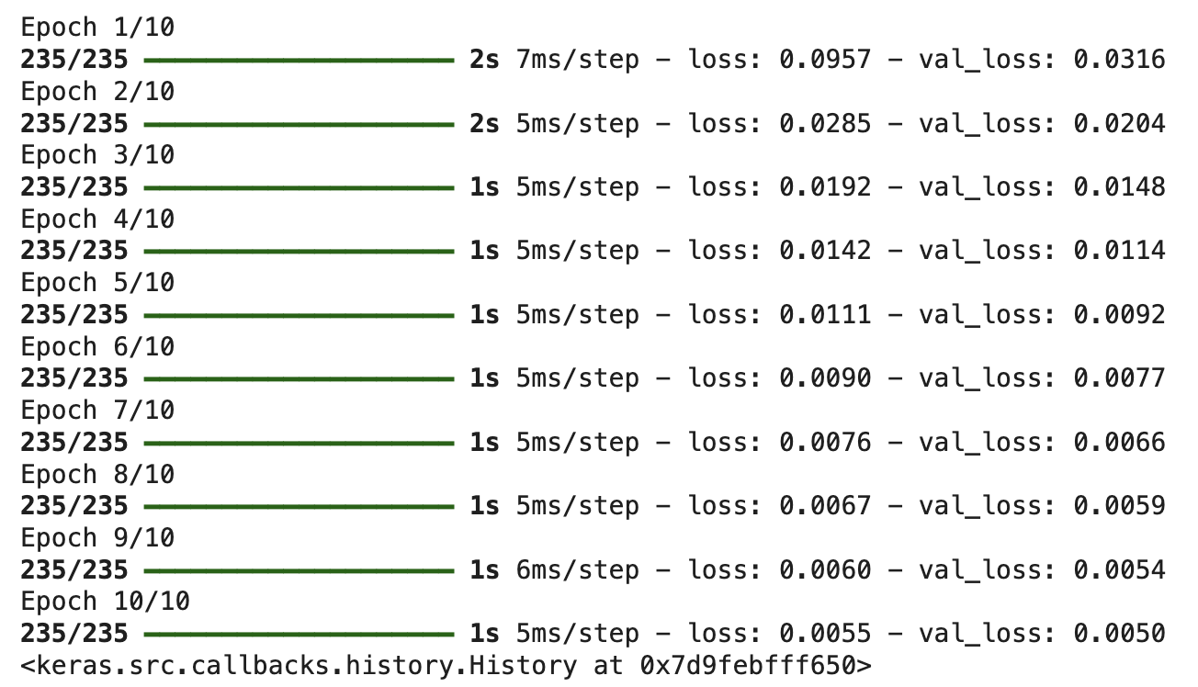
Creation of a basic autoencoder using Keras and TensorFlow
Step 4: Compiling and Fitting the Autoencoder
Here, we instantiate our SimpleAutoencoder with a latent dimension of 64. We then compile the model, specifying the Adam optimizer and Mean Squared Error (MSE) as the loss function, as our goal is to minimize the difference between original and reconstructed images. Finally, we train the autoencoder on the MNIST training data, using the training data itself as both input and target, and validate its performance on the test set.
latent_dimensions = 64
autoencoder = SimpleAutoencoder(latent_dimensions) autoencoder.compile(optimizer='adam', loss=losses.MeanSquaredError()) autoencoder.fit(x_train, x_train, epochs=10, batch_size=256, shuffle=True, validation_data=(x_test, x_test))
OUTPUT

Slide 17
Creation of a basic autoencoder using Keras and TensorFlow
Step 5: Visualize Original and Reconstructed Data
After training, we can visualize the autoencoder's performance. We'll use the encoder to get the compressed representations of test images and then use the decoder to reconstruct them. The plot will show a comparison between a few original test images and their reconstructed counterparts.
encoded_imgs = autoencoder.encoder(x_test).numpy()
decoded_imgs = autoencoder.decoder(encoded_imgs).numpy()
n = 6
plt.figure(figsize=(12, 6))
for i in range(n):
# Display original images
ax = plt.subplot(2, n, i + 1)
plt.imshow(x_test[i].reshape(28, 28), cmap='gray’)
plt.title("Original")
plt.axis('off’)
# Display reconstructed images
ax = plt.subplot(2, n, i + 1 + n)
plt.imshow(decoded_imgs[i].reshape(28, 28), cmap='gray’)
plt.title("Reconstructed")
plt.axis('off’)
plt.show()

Slide 18
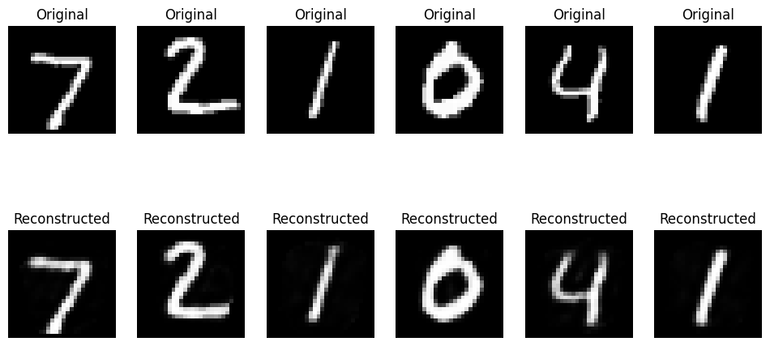
Creation of a basic autoencoder using Keras and TensorFlow
OUTPUT

Slide 19
Limitations of Autoencoders
Memorizing Instead of Learning Patterns: Autoencoders can sometimes simply "memorize" the training data, learning to copy the input directly rather than extracting meaningful, generalized patterns. This leads to poor performance on new, unseen data, limiting their ability to generalize.
Imperfect Reconstructed Data: The reconstructed output from an autoencoder might not always be perfect; it can sometimes appear blurry or distorted. This occurs when the model struggles to capture fine details, especially with noisy input or if the architecture isn't complex enough for the data.
Dependency on Data Size and Parameter Tuning: Effective performance of an autoencoder typically requires a large dataset and meticulous tuning of its parameters (such as the latent space size or learning rate). Insufficient data or poor tuning can prevent the model from learning useful representations, leading to suboptimal results.

Slide 20
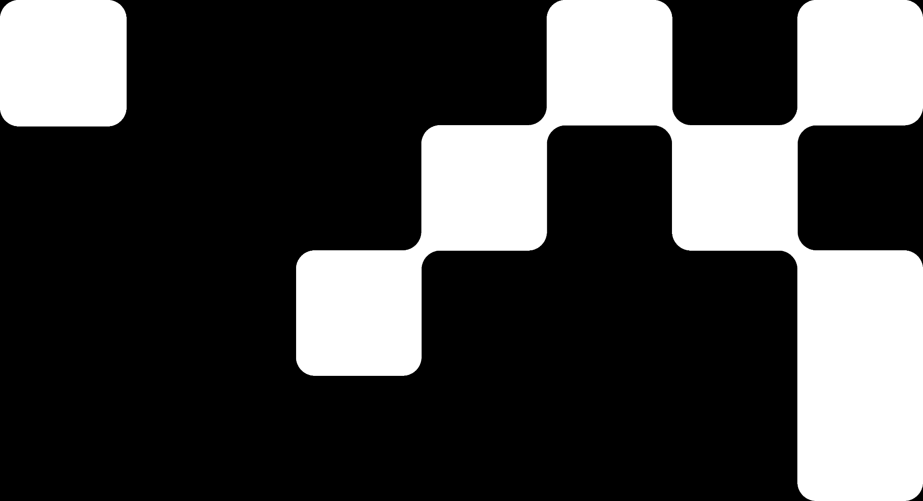

Hands On Exercise
Click Here For The Implementation on Google Colab
https://drive.google.com/file/d/1PiOm8C_iKyRlnpc_lxibehgEqTTGMsDX/view?usp=share_link

Slide 21
Books and References
"Neural Networks and Deep Learning" (Michael Nielsen)
Deep Learning for Computer Vision (Rajalingappaa Shanmugamani)
https://www.geeksforgeeks.org/generative-adversarial-network-gan/
Goodfellow, I., Bengio, Y., & Courville, A. (2016). Deep Learning. MIT Press.
Chollet, F. (2017). Deep Learning with Python. Manning Publications.
Hochreiter, S., & Schmidhuber, J. (1997). Long Short-Term Memory. Neural Computation.

Slide 22

















الشراكات العالمية

Slide 23
شــــــكــــرًا لكــــــم
THANK YOU

